Slide 1
Lecture # 19-20
Dr. M. Nadeem

Slide 2
Types of Queues
1. Simple Queue
2. Deque
3. Circular Queue
4. Priority Queue

Slide 3
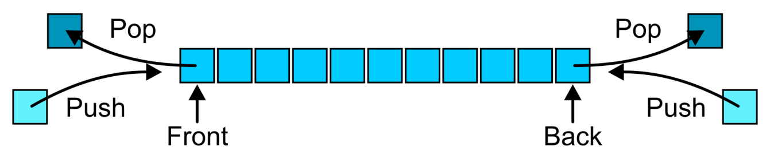
What is deque ?
Deque stands for double ended queue.
It Allows elements to be added or removed on either the ends (front or rear).

Slide 4
DEQUES
Deque is also known as head-tail linked list.
insertion
insertion
34 | 12 | 53 | 61 | 9
front
rear
deletion
deletion

Slide 5
Types Of Deque
1.Input restricted deque:
insertion
34 | 12 | 53 | 61 | 9
front
rear
deletion
deletion
2. Output restricted deque:
insertion
insertion
34 | 12 | 53 | 61 | 9
front
rear
deletion

Slide 6
Types Of Deque
Input-restricted deque
Deletion can be made from both ends , but
Insertion can be made at one end only.
Output-restricted deque
Insertion can be made at both ends , but
Deletion can be made from one end only.

Slide 7
Example of deque Operation
Operation | deque Contents | Return Value
isEmpty() | [] | True
pushFront(‘a’) | [‘a’]
pushFront(‘b’) | [‘b’ , ‘a’]
pushRear(‘c’) | [‘b’ , ‘a’ , ‘c’]
popFront() | [‘a’ , ‘c’] | ‘b’
isEmpty() | [‘a’ , ‘c’] | False
popRear() | [‘a’] | ‘c’

Slide 8
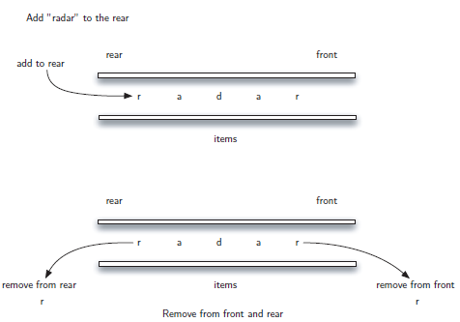
deque Applications
Palindrome Checker
Madam, Radar, Malayalam are some examples for palindrome

Slide 9
deque Applications
Undo - Redo operation in software applications

Slide 10
Deque as Stack and Queue
As STACK
When insertion and deletion is made at the same side.
As Queue
When items are inserted at one end and removed at the other end.

Slide 11
OPERATIONS IN DEQUE
Insert element at back
Insert element at front
Remove element at front
Remove element at back

Slide 12
Operations
pushRear() - Insert element at back
pushFront() - Insert element at front
popRear() - Remove last element
popFront() - Remove first element
isEmpty() – Checks whether the queue is empty or not.

Slide 13
Insert from Front
insert_front() is a operation used to push an element into the front of the Deque.
PUSH 0
1 2 3 4 5 7
FRONT
REAR
0 1 2 3 4 5 7

Slide 14
Insert from Rear
insert_back() is a operation used to push an element at the back of a Deque.
1 2 3 4 5 7
PUSH 9
FRONT
REAR
1 2 3 4 5 7

Slide 15
Deletion from Front
remove_front() is a operation used to pop an element on front of the Deque.
POP
1 2 3 4 5 7
FRONT
REAR
2 3 4 5 7

Slide 16
Deletion from Rear
remove_rear() is a operation used to pop an element on front of the Deque.
1 2 3 4 5 7
POP
FRONT
REAR
1 2 3 4 5

Slide 17
Algorithm for Insertion at Rear end
DEQUE_INS_REAR ( DEQUE, Rear, Front, Max, item )
1. Start
2. if(Rear==MAX) [Check for overflow]
3. Display "Queue is Overflow”
4. return;
else [Insert element]
If Front=0 then
7. Front=1;
8. Endif
9. Rear=Rear+1;
10. DEQUE[Rear]=item;
11. return

Slide 18
Algorithm for Insertion at Front end
DEQUE_INS_Front ( DEQUE, Rear, Front, no )
1. Start
[Check for the front position]
If(Front<=1)
Display “Cannot add item at front end”
4. return;
Else [Insert at front]
Front=Front-1;
7. DEQUE [Front]=no;
8. Endif
9. Return

Slide 19
Algorithm for Deletion from Front end
DEQUE_Del_Front ( DEQUE, Rear, Front, item )
1. Start
if Front=0 [ Check for front pointer]
Display " Queue is Underflow”
4. return;
5. Else [Perform deletion]
6. item =DEQUE[Front];
Display “Deleted element is”+item
[Set front and rear pointer]
9. if Front=Rear
10. Front=0;
11. Rear=0;
12. else
13. Front=Front+1;
14. Return

Slide 20
Algorithm for Deletion from Rear end
DEQUE_Del_Rear ( DEQUE, Rear, Front, item )
1. Start
2. if Rear=0 [Check for the rear pointer]
3. Display “Cannot delete value at rear end”
4. return;
5. else [ perform deletion]
item =DEQUE[Rear];
if Front= Rear [Check for the front and rear pointer]
8. Front=0;
9. Rear=0;
Else
Rear=Rear-1;
12. Display “Deleted element is”+item
13. Return

Slide 21
Insertion in Double-Ended Queue.
Step 1: [Check overflow condition]
If rear >= n and front = 0
Output “overflow” and return
Step 2: [Check front pointer value]
If front > 0
front = front – 1
else
return
Step 3: [Insert element at the front end]
Q [front] = value
Step 4: [Check rear pointer value]
If rear < n
rear = rear + 1
else
return
Step 5: [Insert element at the rear end]
Q [rear] = value
Step 6: return

Slide 22
Deletion in Double-Ended queue
Step 1: [Check for underflow]
If front = 0 and rear = 0
Output “Underflow” and return
Step 2: [Delete element at front end]
If front > 0
Value = Q [front]
Return (value)
Step 3: [Check queue for empty]
If front = rear
front = rear = 0
else
front = front + 1
Step 4: [Delete element at the rear end]
If rear > 0
Value = Q [rear]
Return (value)
Step 5: [Check queue for empty]
If front = rear
front = rear = 0
else
rear = rear – 1
Step 6: return

